Slide 1
PUBG ALL STARS presented by- Tanul Agarwal

Slide 2
Problem statement
The purpose of this website is to view ongoing tournaments in PUBG and play them.

Slide 3
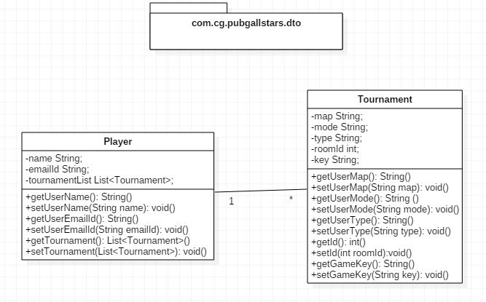
POJO Classes with Relationship

Slide 4
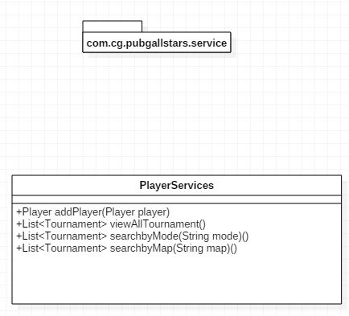
Service references

Slide 5
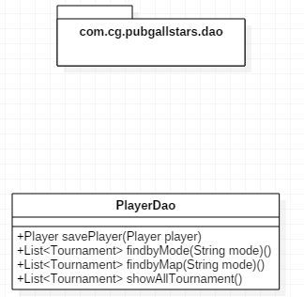
Repository

Slide 6
THANKYOU.

